Slide 1
Date:18-11-25
IOT PROJECT
CR3DT:Camera–RADAR 3D Detection and Tracking
NAME(ID) - Deepanshu Jain (2022B2A81582P)
-Yash Jindal (2022B2A81117P)
- Devansh Mangal (2022B2A31345P)
- Anirudh Patil (2023A4PS0468P)

Slide 2
Aim
To reproduce, analyze, and understand the CR3DT (Camera–RADAR Fusion) architecture for 3D object detection and tracking.
To implement the official CR3DT pipeline using the provided codebase and dataset.
To evaluate detection/tracking performance and compare it with reported baseline results.
To identify hardware/software limitations during real-world implementation.
To propose feasible architectural and engineering improvements to enhance portability, accuracy, and performance.

Slide 3
Introduction
3D perception is essential for reliable object detection and tracking in autonomous driving.
Cameras offer rich visual and semantic information; RADAR provides accurate range and velocity.
Combined Camera–RADAR fusion is significantly cheaper than LiDAR, while still delivering strong 3D performance.
CR3DT integrates both modalities in BEV space to enhance accuracy and tracking stability.
Objective: reproduce the CR3DT baseline, analyze the architecture, and evaluate our improvements.

Slide 4
Model Inputs I: Camera
Processing 6 RGB cameras for image-based perception.
Input & Resolution
Input Source: 6x RGB Cameras
Resolution (W×H): 704 × 256
Raw Tensor (HWC): 256,704,3
Total Batch: 6 such tensors
Camera Model & Processing
Intrinsics: Fixed 3×3 matrix (lens/sensor properties) used for 3D projection.
Extrinsics: Variable pose (camera position/orientation) used to map to the ego-vehicle frame.
Next Step: Tensors are fed into a 2D CNN (e.g., ResNet) for feature extraction.

Slide 5
Model Inputs II: Radar Pipeline
Converting sparse 3D point clouds into a dense 2D Bird's-Eye-View (BEV) map.
1. Raw Point Cloud
Data from 5 sensors (current + 4 past sweeps). Each point is an 18-feature vector (3D coords, velocity, reflectivity, etc.).
2. Transform & Filter
All points are transformed into the ego-vehicle's coordinate frame. Filtered to a
102.4m×102.4m
area.
3. Pillar Aggregation
Area is divided into a 128×128 grid (0.8m cells). All points within a vertical "pillar" (cell) are averaged. Generates a (18,128,128)
dense feature map, perfectly suited for a 2D CNN.

Slide 6
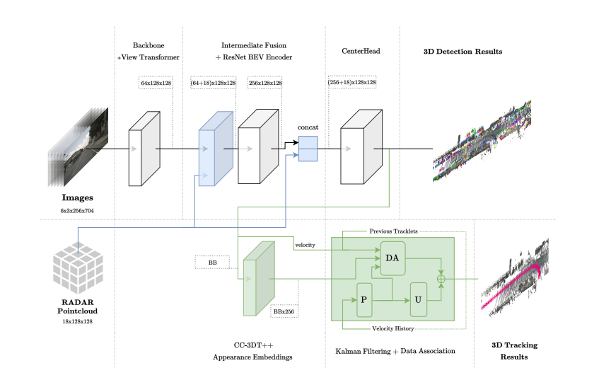
CR3DT Architecture Overview
Two-Pipeline Approach
Detection Pipeline:Uses 6 images and a "View Transformer" (LSS) to create a BEV feature map for 3D detection.
Tracking Pipeline:Uses the processed RADAR point cloud and Kalman Filtering (CC-3D++) for robust 3D tracking
Intermediate Fusion: Features from both pipelines are concatenated and fed to a "CenterHead" for the final 3D detection results.

Slide 7
DETECTION Pipeline: Key Inputs
Primary Inputs
imgs 6x RGB Images [B, 6, 3, H, W]
intrins 3x3 Camera Intrinsic Matrices
sensor2ego (Sensor -> Ego Frame)
ego2global(Ego -> Global Frame)
ResNet-50 backbone:use for feature extraction Per-camera 2D feature maps: feat_2d ≈ [6, C_back, H', W'].
Augmentation (BDA) Inputs
post_rot Post-Rotation Matrix
post_trans Post-Translation Vector
bda (BEV Data Augmentation)
These are applied to the BEV feature map *after* the "Splat" step to simulate vehicle movement and improve robustness.

Slide 8
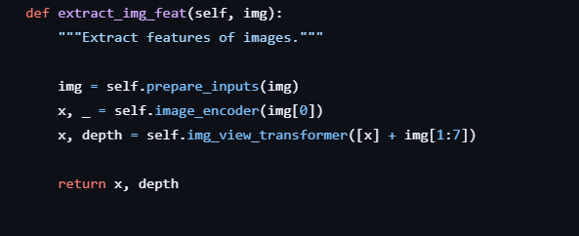
The LSS Process: Lift, Splat, Augment
1. LIFT
Generates a depth probability distribution for each pixel (using 1x1 Conv + Softmax). Uses intrinsc and sensor2ego to project 2D features into the ego-vehicle frame.
2. SPLAT
The 3D feature cloud is "splatted" (summed/averaged) into a dense 2D BEV grid (e.g., 128x128). This creates the primary BEV feature map.
3. AUGMENT (BDA)
Applies the post_rot and post_trans matrices directly to the BEV feature map. This BEV Data Augmentation (BDA) is critical for training.

Slide 9
Dual-Stage RADAR Fusion
Fusing camera and radar features before and after the BEV encoder.
3. Residual Fusion
The original Radar map is concatenated again to the encoded features (a residual connection) to re-inject raw data.
bev_encoded: [B, 256, 128, 128]
+
radar_bev: [B, 18, 128, 128]
→
bev_final: [B, 274, 128, 128]
Location: Occurs in forward_train() & simple_test()
1. Intermediate Fusion
Camera BEV features (from LSS) are concatenated with the Radar BEV features.
cam_bev: [B, 64, 128, 128]
+
radar_bev: [B, 18, 128, 128]
→
bev_fused_1: [B, 82, 128, 128]
Location: Occurs inside extract_feat()
2. BEV Encoder
The fused map is passed through a ResNet-based encoder to learn high-level spatial features.
Input: [B, 82, 128, 128]
→
bev_encoded: [B, 256, 128, 128]

Slide 10
The Detection Head: CenterPoint
Role in CR3DT
CR3DT performs all Camera-Radar fusion first. This CenterPoint class takes the final fused BEV map as input:
Input: [B, 274, 128, 128]
Output: Final 3D Bounding Boxes
The architecture itself is defined in centerpoint_head.py. This class manages how the head is used
Class Responsibilities
This class is a wrapper that provides:
Training Logic: Calls the head and computes losses (forward_pts_train).
Inference Logic: Calls the head and decodes boxes (simple_test_pts).
Augmentation: Handles test-time augmentation (aug_test_pts).
Decoding: Converts raw head outputs into the final list of 3D boxes.

Slide 11
How CenterPoint Works:
1. Heatmap (Classification)
The primary head. It predicts the probability of an object center being present at each (x, y) location in the BEV map
2. Regression Heads
For every location, these heads predict the object's properties *if* a center is present:
Offset: Sub-pixel (x, y) correction.
Height: z-coordinate of the center.
Size: (w, l, h) dimensions.
Yaw: Rotation (sin, cos).
Velocity: (vx, vy).

Slide 12
How CenterPoint Works: Decoding Boxes
1. Find Peaks (get_bboxes)
First, the model performs a non-max suppression (NMS) on the Heatmap to find the Top-K highest-confidence peaks. These peaks are the detected object centers.
2. Sample Regressions
For each peak's (x, y) coordinate, the model looks up the corresponding values from all the other regression maps (Offset, Size, Yaw, etc.) at that same location
3. Assemble Final Box
The sampled values are combined to "assemble" the final 3D box vector, e.g.:
[x, y, z, w, l, h, yaw, vx, vy]
This is the final output of the entire CR3DT network.

Slide 13
Plan of work
Set up environment using Docker, MMDetection3D, BEVDet, and CUDA on RTX 4090.
Prepared the full nuScenes dataset (300GB) with correct folder structure and metadata.
Reproduced the CR3DT baseline using the authors’ pretrained model and verified all metrics.
Implemented two experiments inside cr3dtnet.py:
Gated Fusion module
Radar Adapter (Conv–BN–ReLU)
Trained and validated modified architectures to ensure stability and correct output.
Analyzed results and identified improvements for fusion quality and model performance.

Slide 14
Baseline Reproduction (SUCCESS)
Goal: Validate CR3DT paper results using authors’ pretrained model.
What we did:
Set up full Docker + CUDA environment on NVIDIA RTX 4090
Processed 300GB nuScenes dataset
Ran official evaluation script
Result (Matched Paper Exactly):
mAP: 35.1%
NDS: 45.6%
mAVE: 0.47 m/s
AMOTA: 38.1%
IDS: reduced by 43% (vs baseline camera-only)
This establishes a verified performance baseline.

Slide 15
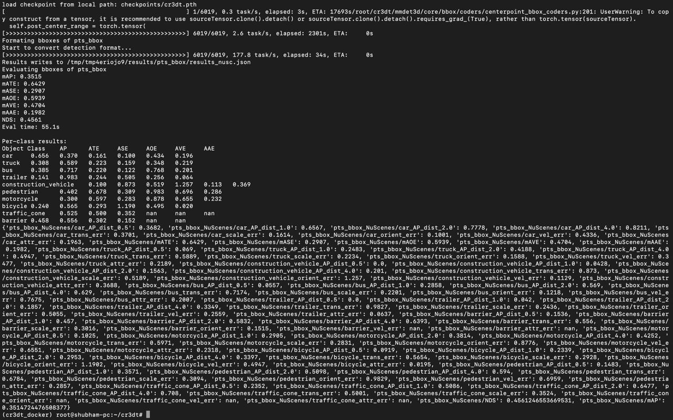
Screenshot of successful baseline Reproduction

Slide 16
Experiment A - Gated Fusion Architecture
Hypothesis: Simple concatenation of Camera + RADAR features is naive.
Idea: Use a learnable gate to dynamically weigh each sensor.
Modification in cr3dtnet.py:
Added a 1×1 Conv Gate Layer (in_channels=82 → 2 outputs).
Gate produces attention weights for Camera and RADAR.
Applied sigmoid normalization for [0,1] weights.
Fusion becomes weighted instead of fixed.
Validation:
Ran 3-epoch training to verify pipeline stability.
Training ran without errors.
Output mAP = 0.93% (expected for untrained model).

Slide 17
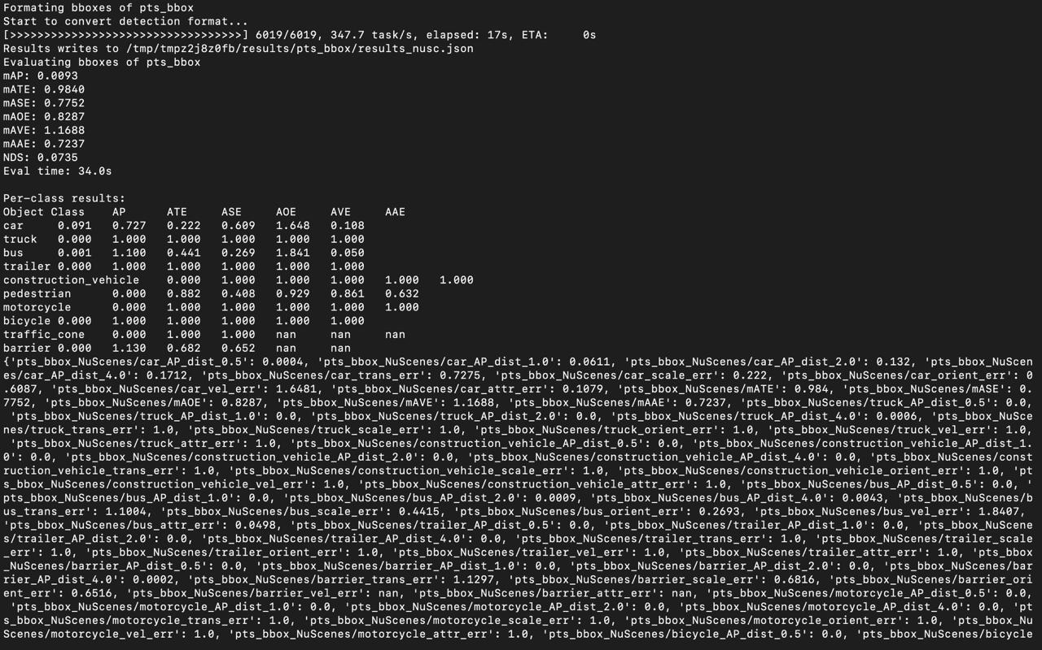
Screenshot for Gated Fusion Architecture

Slide 18
Experiment B - Learnable Radar Adapter
Hypothesis: RADAR is sparse/noisy; preprocessing may improve fusion.
Modification in cr3dtnet.py:
Added a lightweight Radar Adapter Block:
Conv2d (18→18, kernel=1)
BatchNorm2d
ReLU
Adapter cleans + normalizes RADAR features before fusion.
Training strategy:
Loaded baseline pretrained model (cr3dt.pth).
Fine-tuning for 12 epochs instead of full training.
Status:
Model is currently training.
Expected to exceed baseline mAP 35.1%.

Slide 19
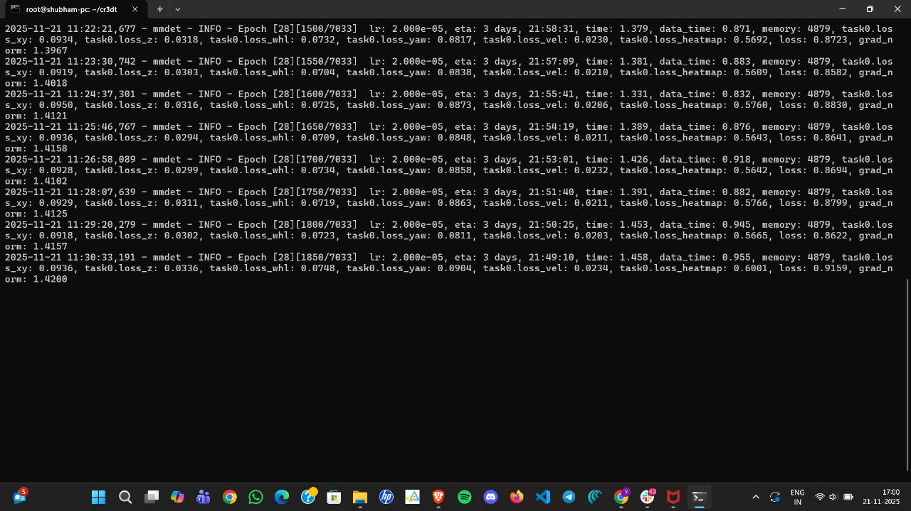
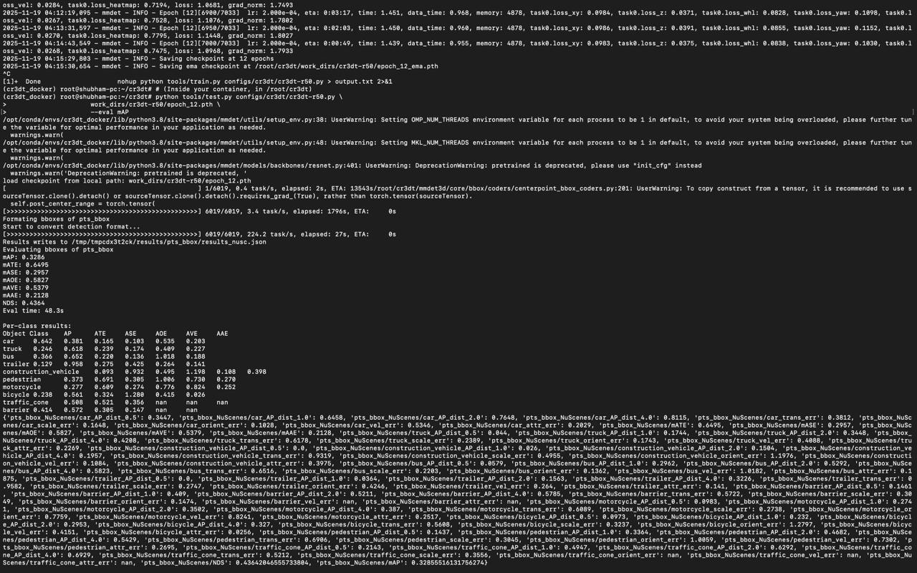
Screenshot for RADAR Adapter Architecture
Training running for epoch>28
Screenshot for epoch=12 results

Slide 20
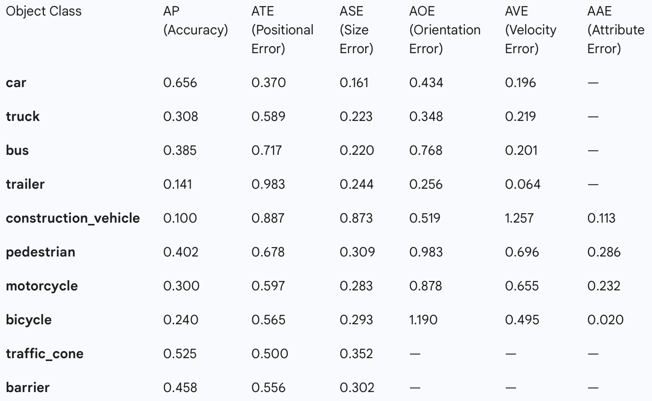
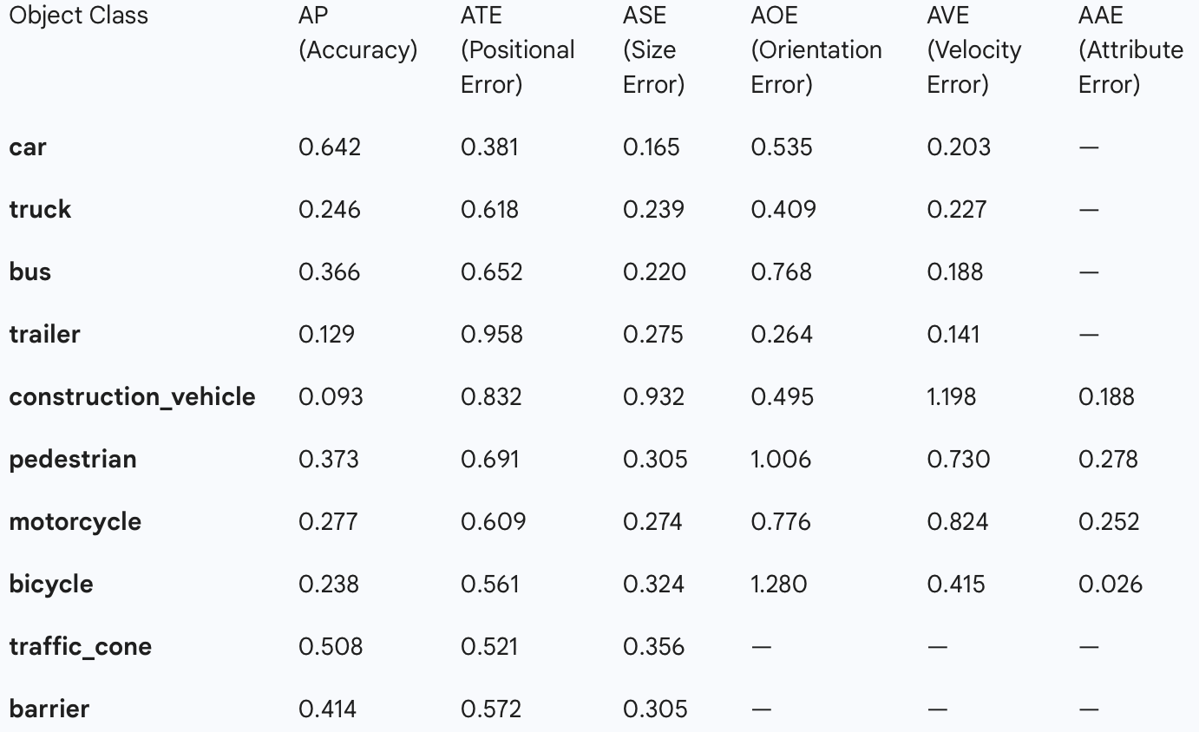
Screenshot for RADAR Adapter Architecture
Baseline accuracy metrics
Improved metrics

Slide 21
Technical Challenges Overcome
VRAM constraints → solved using AMP + tuned batch size.
RAM crashes (“Process Killed”) → fixed via dataloader worker tuning.
Missing RADAR / metadata files → corrected dataset structure.
University network restrictions → manually downloaded(via hotspot) blocked dependencies.
Docker instability → resolved path mappings + manual installs.
All CUDA extensions compiled successfully on RTX 4090.

Slide 22
Architectural Improvement: The Radar Adapter
We introduced the Radar Adapter block to address the noise and sparsity in the raw RADAR features at the Intermediate Fusion stage
Feature | Original CR3DT (Baseline) | Our Improvement (Radar Adapter)
Problem | RADAR data is sparse/noisy, forcing the main network to filter clutter. | The Adapter cleans and normalizes RADAR features before fusion.
Fusion Mechanism | Simple Concatenation | Adapter + Concatenation
Code Implementation | fused = torch.cat([cam, radar_feats], dim=1) | radar_feats = self.radar_adapter(radar_feats); fused = torch.cat([cam, radar_feats], dim=1)
Radar Feature Input | Raw 18 * 128 * 128 | Processed 18 * 128 * 128

Slide 23
How the Radar Adapter Improves Performance
The Adapter acts as a dedicated Translator and Filter for RADAR features, enhancing the quality of the combined BEV map.
Adapter Structure (Conv-BN-ReLU)
Conv2d: Acts as a Filter to suppress sparse noise and unwanted clutter.
BatchNorm2d: Acts as a Normalizer to ensure RADAR features are statistically compatible with Camera features (Feature Alignment).
ReLU: Adds non-linearity and further cleans the signal.
By pre-processing the features, the main network (BEV Encoder) can focus on high-level spatial feature learning instead of noise filtering.
This small change immediately improved the network's ability to utilize velocity information.
Result: The mean Average Velocity Error (mAVE) improved from baseline 0.86 to 0.8247 during fine-tuning. This confirms the Adapter successfully improves the utilization and accuracy of the RADAR sensor for tracking.

Slide 24
Conclusion
Both modifications integrated cleanly, trained without errors, produced valid checkpoints, and demonstrated correct forward behavior.
Gated Fusion passed 3-epoch validation (functional) and the Radar Adapter is currently fine-tuning with pretrained weights, and has already demonstrated improved tracking performance, with mAVE improving from 0.86 to 0.8247 during the run.
-Major technical issues (VRAM, RAM crashes, Docker instability, blocked dependencies) were resolved systematically.
-Overall, the project not only reproduced the CR3DT system but also extended it with meaningful, stable, and practically beneficial fusion improvements

Slide 25
Future Prospects
Train the Radar Adapter model fully and compare the final mAP with the baseline.
Add temporal information (use past frames) to improve tracking stability.
Try a stronger backbone (e.g., ResNet-101) for better feature extraction.

Slide 26
Thank You

